Slide 2
Exploratory data analysis (EDA)
Exploratory data analysis is an approach for analyzing data sets to summarize their main characteristics, often with visual methods
EDA is statisticians way of story telling where you explore data, find patterns and tells insights

Slide 3
Exploratory data analysis (EDA)
EDA usually employs graphical techniques to get better understanding of data, such as Histograms, Line charts, Box plots etc.
However, some other techniques like tabulation, clustering, simple model building can also be used
Often undetected errors in data are discovered here

Slide 4
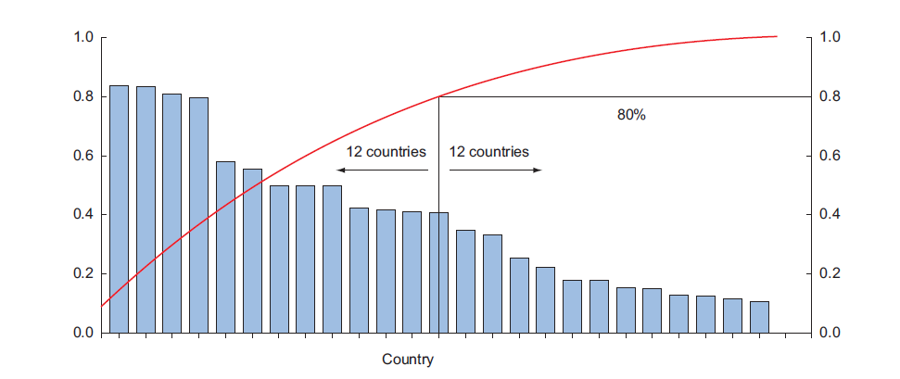
Exploratory data analysis (EDA)
Overlay plots is also a useful EDA technique, such as Pareto diagram
Overlay Plot allows one or more new plot curve(s) to be drawn over existing plots using data from a Parametric, Lookup, Arrays, or Integral table.
Notes:
Overlay plots are composed of layers; each layer contains one plot, and the layers are stacked on top of each other to create the combined plot.

Slide 5
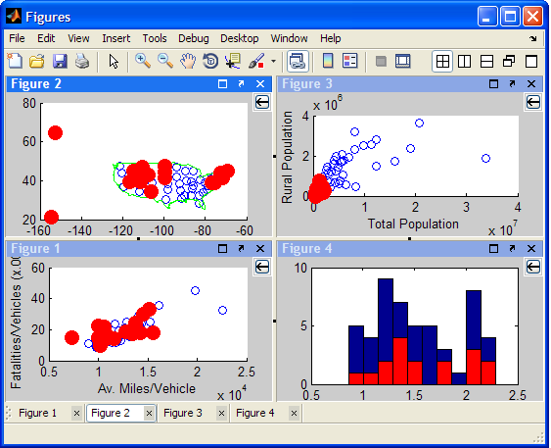
Exploratory data analysis (EDA)
Brushing and Linking (IVA)

Slide 6
Pandas Library
Pandas is a Python library that provides extensive means for data analysis
Data scientists often work with data stored in table formats like .csv, .tsv, or .xlsx
Pandas makes it very convenient to load, process, and analyze such tabular data using SQL-like queries
In conjunction with Matplotlib and Seaborn, Pandas provides a wide range of opportunities for visual analysis of tabular data

Slide 7
Pandas Library
The main data structures in Pandas are implemented with Series and DataFrame classes
Series is a one-dimensional indexed array of some fixed data type
DataFrame is a two-dimensional data structure - a table - where each column contains data of the same type
It as a dictionary of Series instances
rows correspond to instances (examples, observations, etc.), and
columns correspond to features of these instances.

Slide 8
Importing Libraries
Code:
import numpy as np
import pandas as pd
# we don't like warnings
# you can comment the following 2 lines if you'd like to
import warnings
warnings.filterwarnings('ignore')

Slide 9
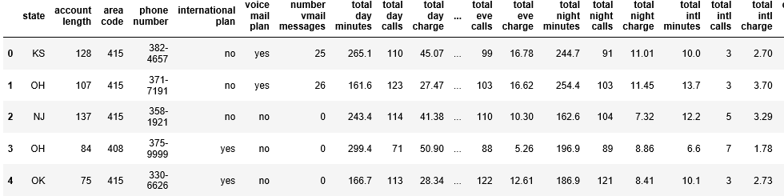
Analyzing a dataset on the churn rate of telecom operator clients
Read the data (using read_csv), and take a look at the first 5 lines using the head method
Code:
df = pd.read_csv('Desktop/Python Tutorial/telecom_churn.csv')
df.head()
Each row corresponds to one client, an instance, and columns are features of this instance.

Slide 10
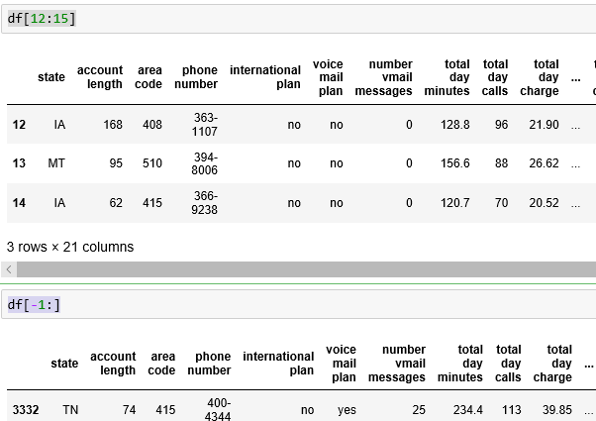
Retrieving data
If we need the first or the last line of the data frame, we can use the df[:1] or df[-1:] construct:
Code:
df[12:15]
df[-1:]

Slide 11

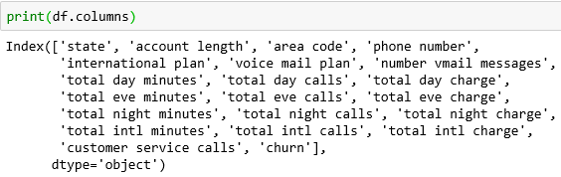
Data dimensionality, feature names, and feature types
Code:
Data Dimensionality:
print(df.shape)
Printing out column names using columns:
print(df.columns)

Slide 12
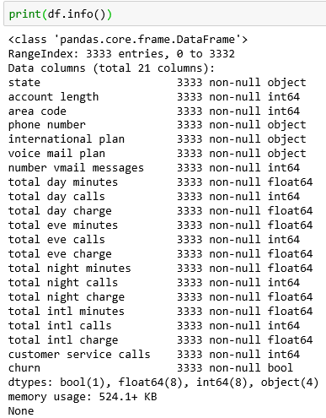
Feature types:
Use the info() method to output some general information about the dataframe.
Code:
print(df.info())
bool, int64, float64 and object are the data types of our features
With this same method, we can easily see if there are any missing values

Slide 13
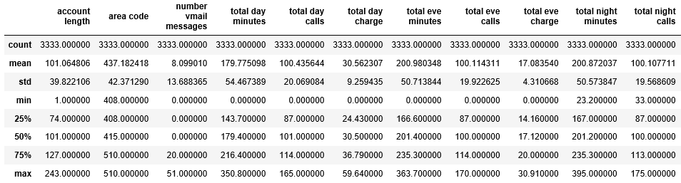
Changing the Feature Type
The number of individuals or items moving out of a collective group over a specific period.
Change the column type with the astype method
Let’s apply this method to the churn feature to convert it into int64
The describe method shows basic statistical characteristics of each numerical feature (int64 and float64 types)
number of non-missing values, mean, standard deviation, range, median, 0.25 and 0.75 quartiles
Code:
df['churn'] = df['churn'].astype('int64’)
df.describe()

Slide 14
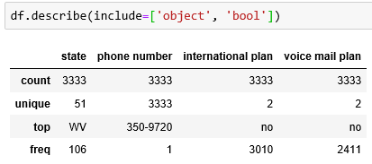
Statistics of non-numerical features
Explicitly indicate data types of interest in the include parameter
Code:
df.describe(include=['object', 'bool'])

Slide 15
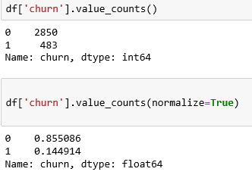
Statistics of Categorical (type object) and Boolean (type bool) features
For categorical (type object) and boolean (type bool) features we can use the value_counts method
Let’s have a look at the distribution of Churn
Code:
df['churn'].value_counts()
df['churn'].value_counts(normalize=True)

Slide 16
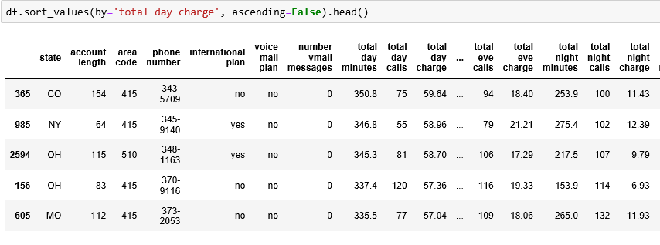
DataFrame Sorting
A DataFrame can be sorted by the value of one of the variables (i.e columns).
For example, we can sort by Total day charge (use ascending=False to sort in descending order)
Code:
df.sort_values(by=‘total day charge', ascending=False).head()

Slide 17
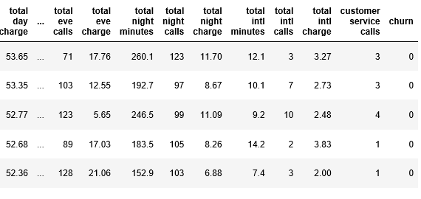
Sort by multiple columns:
Code:
df.sort_values(by=[‘churn', ‘total day charge'],
ascending=[True, False]).head()

Slide 18
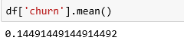
Indexing and retrieving data
A DataFrame can be indexed in different ways.
To get a single column, we can use a DataFrame['Name'] construction
What is the proportion of churned users in our dataframe?
Code:
df[‘churn'].mean()

Slide 19
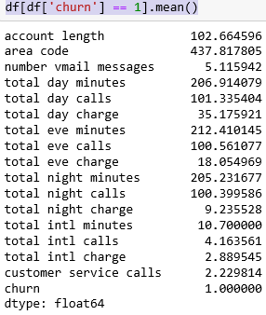
Indexing and retrieving data
(b) Boolean indexing with one column:
The syntax is df[P(df['Name'])], where P is some logical condition that is checked for each element of the Name column.
The result of such indexing is the DataFrame consisting only of rows that satisfy the P condition on the Name column.
What are average values of numerical features for churned users?
Code:
df[df[‘churn'] == 1].mean()

Slide 20
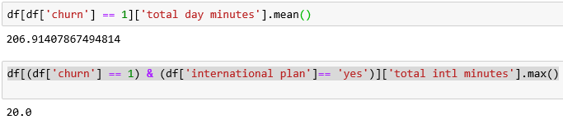
Indexing and retrieving data
How much time (on average) do churned users spend on the phone during daytime?
Code:
df[df['churn'] == 1]['total day minutes'].mean()
What is the maximum length of international calls among loyal users (Churn == 0) who do not have an international plan?
Code:
df[(df['churn'] == 1) & (df['international plan']== 'yes')]['total intl minutes'].max()

Slide 21
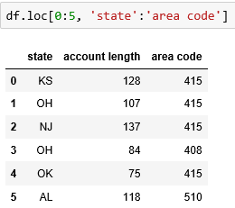
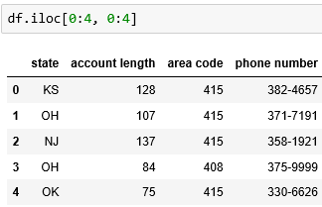
Indexing and retrieving data
(c) DataFrames indexing by column name (label) or row name (index) or by the serial number of a row
The loc method is used for indexing by name, while iloc() is used for indexing by number
In the first case below, we say "give us the values of the rows with index from 0 to 5 (inclusive) and columns labeled from State to Area code (inclusive)"
In the second case, we say "give us the values of the first five rows in the first three columns" (as in a typical Python slice: the maximal value is not included)
Code:
df.loc[0:5, 'State':'Area code’]
df.iloc[0:4, 0:4]

Slide 22
Indexing and retrieving data
(d) If we need the first or the last line of the data frame, we can use the df[:1] or df[-1:] construct:
Code:
df[12:15]
df[-1:]

Slide 23
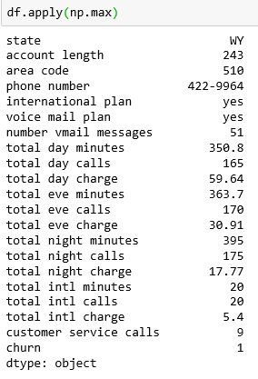
Applying Functions to Cells, Columns and Rows
To apply functions to each column, use apply():
The apply method can also be used to apply a function to each row.
To do this, specify axis=1
Code:
df.apply(np.max)
How to a particular Row?
Home Task

Slide 24
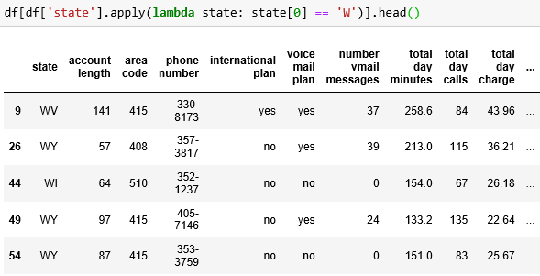
Applying Functions to Cells, Columns and Rows
Lambda function:
If we need to select all states starting with W, we can do it like this:
Code:
df[df[‘state'].apply(lambda state: state[0] == 'W')].head()

Slide 25

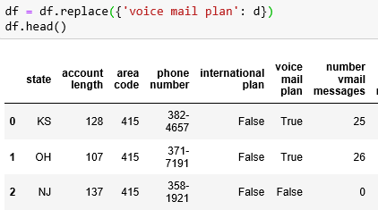
Applying Functions to Cells, Columns and Rows
Map function:
The map method can be used to replace values in a column by passing a dictionary of the form {old_value: new_value} as its argument:
Code:
d = {'No' : False, 'Yes' : True}
df['International plan'] = df['International plan'].map(d)
df.head()
The same thing can be done with the replace method:
df = df.replace({'Voice mail plan': d})
df.head()

Slide 26
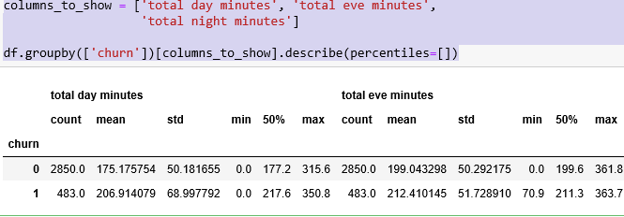
Grouping Data
df.groupby(by=grouping_columns)[columns_to_show].function()
First, the groupby method divides the grouping_columns by their values.
They become a new index in the resulting dataframe.
Then, columns of interest are selected (columns_to_show).
If columns_to_show is not included, all non groupby clauses will be included.
Finally, one or several functions are applied to the obtained groups per selected columns.
Code:
columns_to_show = ['total day minutes', 'total eve minutes’, total night minutes']
df.groupby(['churn'])[columns_to_show].describe(percentiles=[])

Slide 27
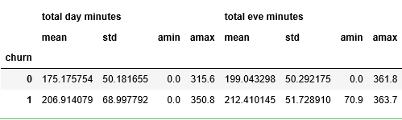
Passing a list of functions to agg():
Grouping Data
Code:
columns_to_show = ['total day minutes', 'total eve minutes',
'total night minutes']
df.groupby(['churn'])[columns_to_show].agg([np.mean, np.std, np.min, np.max])

Slide 28
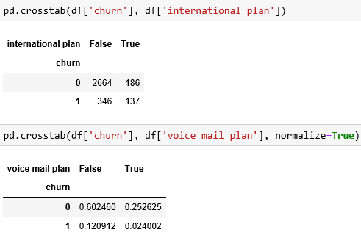
Summary tables
Suppose we want to see how the observations in our sample are distributed in the context of two variables - Churn and International plan
To do so, we can build a contingency table using the crosstab method
Code:
pd.crosstab(df['Churn'], df['International plan'])
pd.crosstab(df['Churn'], df['Voice mail plan'], normalize=True)

Slide 29
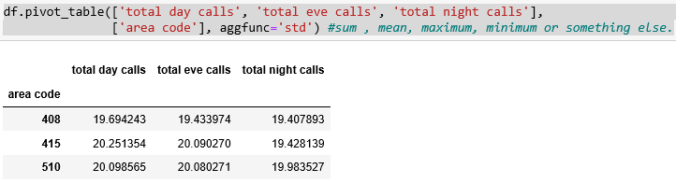
Pivot tables
Pivot_table method takes the following parameters:
values – a list of variables to calculate statistics for
index – a list of variables to group data by
aggfunc – what statistics we need to calculate for groups:
sum, mean, maximum, minimum or something else
Let’s look at the average number of day, evening, and night calls by area code:
Code:
df.pivot_table(['total day calls', 'total eve calls', 'total night calls'], ['area code'], aggfunc='std’)
#sum , mean, maximum, minimum or something else.

Slide 30
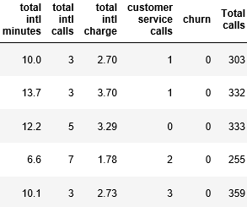
DataFrame transformations
Adding columns to a DataFrame:
For example: Calculate the total number of calls for all users
Create the total_calls Series and paste it into the DataFrame
Code:
total_calls = df['Total day calls'] + df['Total eve calls'] + \
df['Total night calls'] + df['Total intl calls']
df.insert(loc=len(df.columns), column='Total calls', value=total_calls)
df.head()
# loc parameter is the number of columns after which to insert the Series object
# we set it to len(df.columns) to paste it at the very end of the dataframe

Slide 31
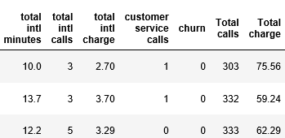
DataFrame transformations
Adding columns to a DataFrame:
Add a column without creating an intermediate Series instance
Code:
df['Total charge'] = df['total day charge'] + df['total eve charge'] + \
df['total night charge'] + df['total intl charge']
df.head()

Slide 32
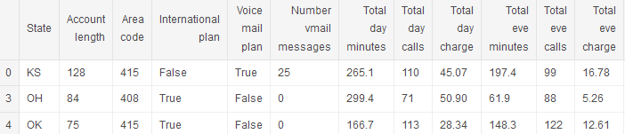
DataFrame transformations
Delete columns or rows
Use the drop method, passing the required indexes and the axis parameter (1 if you delete columns, and nothing or 0 if you delete rows)
The inplace argument tells whether to change the original DataFrame.
With inplace=False, the drop method doesn't change the existing DataFrame and returns a new one with dropped rows or columns.
With inplace=True, it alters the DataFrame.
Code:
# get rid of just created columns
df.drop(['Total charge', 'Total calls'], axis=1, inplace=True)
# and here’s how you can delete rows
df.drop([1, 2]).head()

Slide 33
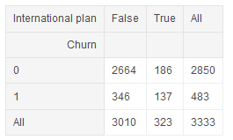
Predicting telecom churn Using a crosstab contingency table
How churn rate is related to the International plan feature.
Using a crosstab contingency table and
Also through visual analysis with Seaborn
Code:
pd.crosstab(df['churn'], df['international plan'], margins=True)

Slide 34
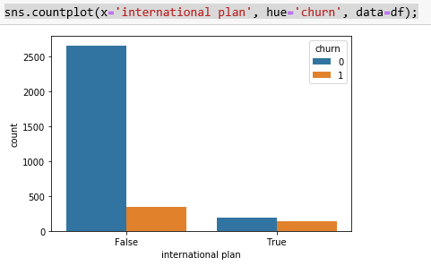
Predicting telecom churn Visual analysis with Seaborn
Code:
# some imports to set up plotting
import matplotlib.pyplot as plt
# pip install seaborn
import seaborn as sns
sns.countplot(x='international plan', hue='churn', data=df);

Slide 35
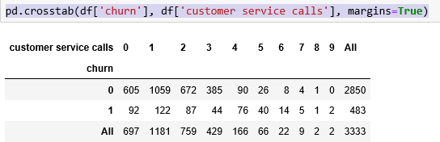
Predicting telecom churn Using a crosstab contingency table
Code:
pd.crosstab(df['churn'], df['customer service calls'], margins=True)

Slide 36
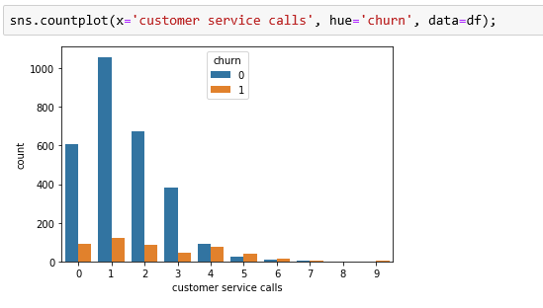
Predicting telecom churn Visual analysis with Seaborn
Code:
sns.countplot(x='Customer service calls', hue='Churn', data=df);

Slide 37
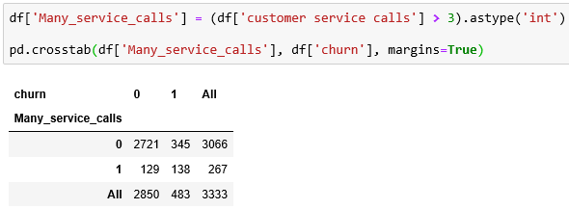
Predicting telecom churn Using a crosstab contingency table
Code:
df['Many_service_calls'] = (df['customer service calls'] > 3).astype('int')
pd.crosstab(df['Many_service_calls'], df['churn'], margins=True)

Slide 38
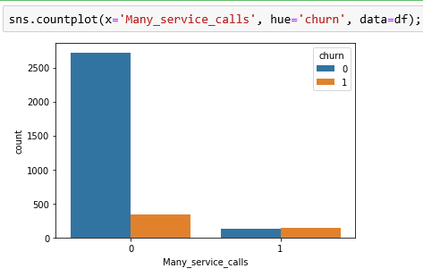
Predicting telecom churn Visual analysis with Seaborn
Code:
sns.countplot(x='Many_service_calls', hue='churn', data=df);

Slide 39
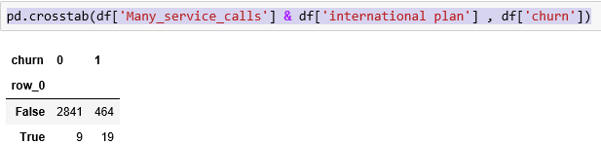
Contingency table that relates Churn with both International plan and freshly created Many_service_calls.
Predicting telecom churn Using a crosstab contingency table
Code:
pd.crosstab(df['Many_service_calls'] & df['international plan'] , df['churn'])

Slide 40
EDA on another Dataset

Slide 41
Preparations
For the preparations lets first import the necessary libraries and load the files needed for our EDA
Code:
import pandas as pd
import seaborn as sns
import matplotlib.pyplot as plt
import warnings
warnings.filterwarnings('ignore')
# Comment this if the data visualisations doesn't work on your side
%matplotlib inline
plt.style.use('bmh')

Slide 42
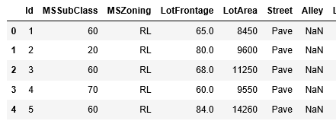
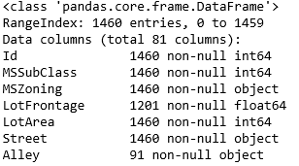
Preparations
Code:
df = pd.read_csv('train.csv')
df.head()
df.info()
Some features won't be relevant in our exploratory analysis as there are too much missing values (such as Alley and PoolQC).
Better to concentrate on the ones which can give us real insights.

Slide 43
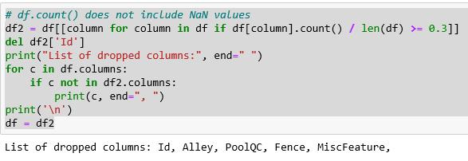
Preparations
Remove Id and
Features with 30% or less NaN values.
Code:
# df.count() does not include NaN values
df2 = df[[column for column in df if df[column].count() / len(df) >= 0.3]]
del df2['Id']
print("List of dropped columns:", end=" ")
for c in df.columns:
if c not in df2.columns:
print(c, end=", ")
print('\n')
df = df2

Slide 44
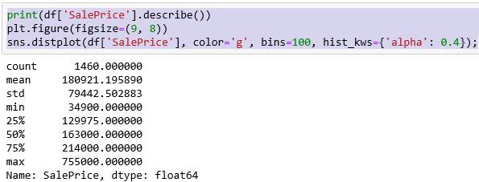
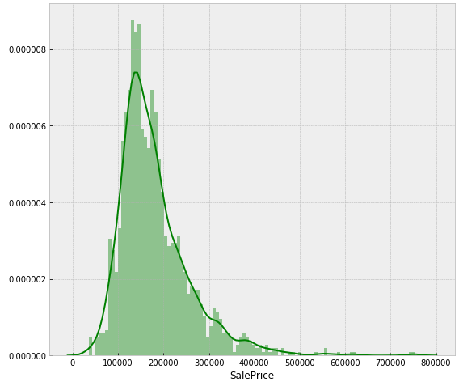
How the housing price is distributed
Code:
print(df['SalePrice'].describe())
plt.figure(figsize=(9, 8))
sns.distplot(df['SalePrice'], color='g', bins=100, hist_kws={'alpha': 0.4});
Prices are skewed right and some outliers lies above ~500,000
We will eventually want to get rid of the them to get a normal distribution of the independent variable (`SalePrice`)
How? Home Task

Slide 45
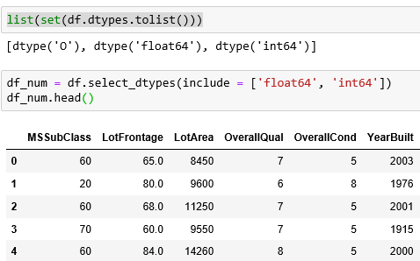
Listing Data from a dataset
List all the types of our data from our dataset and take only the numerical ones:
Code:
list(set(df.dtypes.tolist()))
df_num = df.select_dtypes(include = ['float64', 'int64'])
df_num.head()

Slide 46
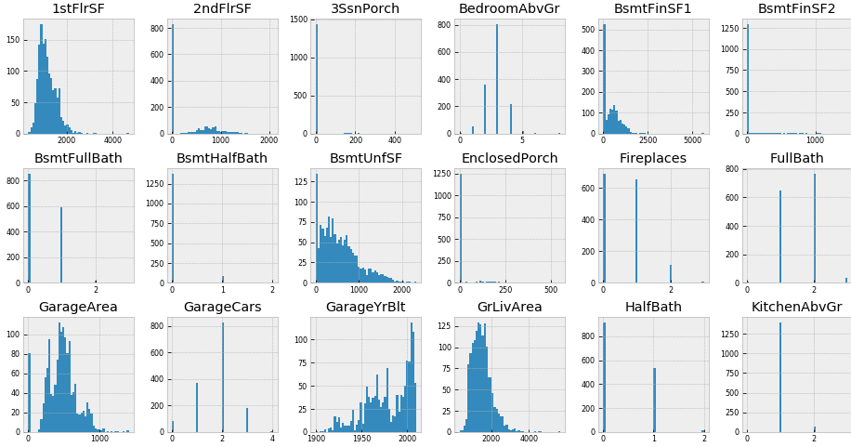
Code:
df_num.hist(figsize=(16, 20), bins=50, xlabelsize=8, ylabelsize=8);
# ; avoid having the matplotlib verbose informations

Slide 47
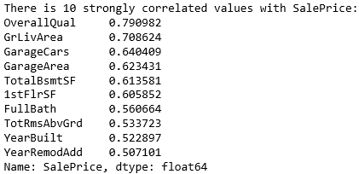
Correlation
Features such as `1stFlrSF`, `TotalBsmtSF`, `LotFrontage`, `GrLiveArea`... seems to share a similar distribution to the one we have with `SalePrice`
Find which features are strongly correlated with SalePrice.
We'll store them in a var called golden_features_list.
We'll reuse our df_num dataset to do so.
Code:
df_num_corr = df_num.corr()['SalePrice'][:-1] # -1 because the latest row is SalePrice
golden_features_list = df_num_corr[abs(df_num_corr) > 0.5].sort_values(ascending=False)
print("There is {} strongly correlated values with SalePrice:\n{}".format(len(golden_features_list), golden_features_list))

